Slide 1
Old Technology – Windows’ Batch Files
I told some friends I was giving a presentation on batch files and they laughed.
It’s an old scooter I’m obsessed with.
Does anybody use Windows' batch files?
I like them and think they are still relevant because you can create self-documenting scripts that you can evolve and perfect over time.

Slide 2
Table of Contents
Part I – The Problem: Batch files are usually balls of mud.
Part II – The Answer in my opinion is functionalization.
Part III – Customization can increase your productivity.

Slide 3
Part I of III - The Problem: Most Batch Files Are A Mess
Most batch files I've seen in the wild are pretty messy. They are often quite long and not well structured. I know this partly because I've written hundreds of them. I wrote batch files for years that were a mess. I like to think I'm a little better now.
For Example, I googled "typical batch file" and this was the first hit:
https://www.instructables.com/id/5-Cool-Batch-Files/

Slide 4
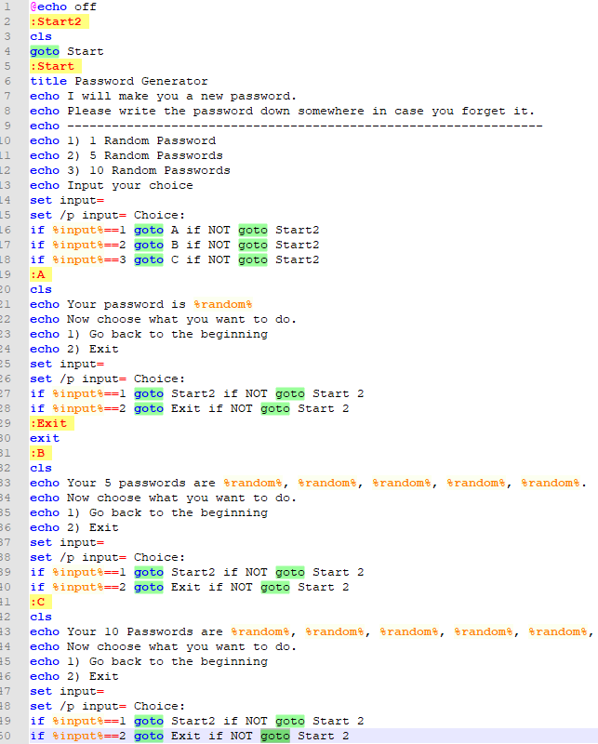
This small file has 19 goto statements! Makes my head hurt looking at it.
The lack of structure is a problem and leads to hard to read and understand code.

Slide 5
Part II of III - How to Modularize? Functionalization
So let's impose some structure. In most programming languages there's a concept of a function.
At the heart of Composable Batch Files is the enforcing the use of traditional functions or code blocks.
Anatomy of a function. Here are the basic structural elements:
* [label] = function name (which must be unique)
* call :[label] = function call to another function in this batch file.
* goto [label] = also a function call, which does not return to the caller. Use judiciously.
* exit/b = end of function. The lack of exit/b is the most common culprit. Without ending
functions, you have spaghetti code.

Slide 6
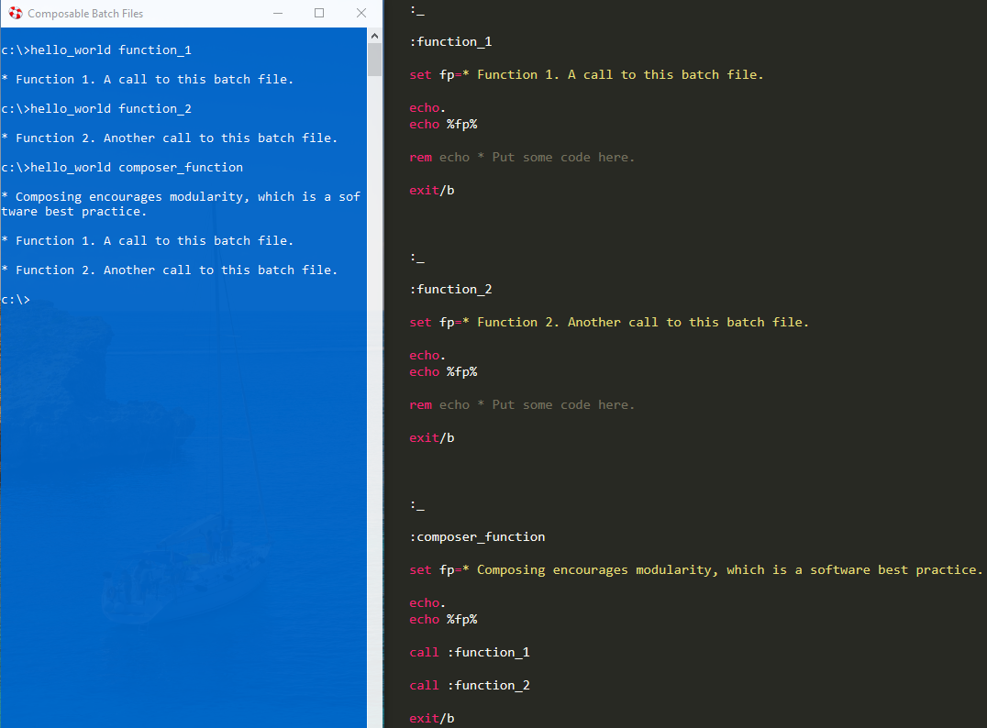
Hello World Demo - A Functionalized Approach
Building the batch file around the a set of functions can turn a normally disorganized environment into a structured and organized one.

Slide 7
Setup Instructions
Add %COMPOSABLE_BATCH_FILES% as an environment variable or, at least, add it to your path to where you installed the repository.
If you so choose, also add these environment variables for the following:
* %CBF_DEFAULT_BROWSER%
* %CBF_DEFAULT_TEXT_EDITOR%
* %CBF_DEFAULT_REPOSITORY_FOLDER%

Slide 8
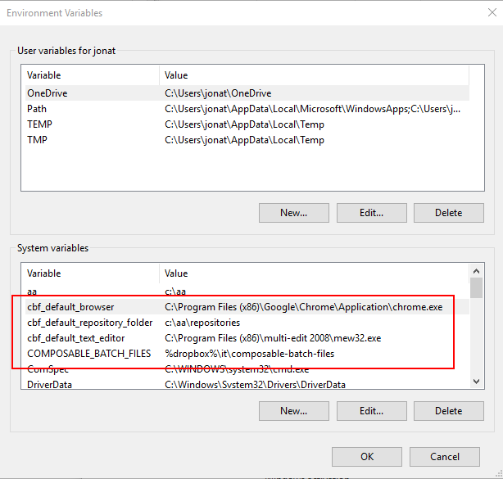
Here's an example of how to set some CBF default environment variables:

Slide 9
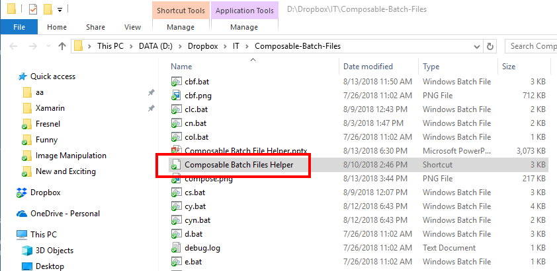
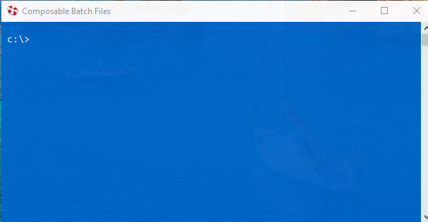
Done with Setup
After you have cloned or downloaded the CBF repository, double click the shortcut titled "Composable Batch Files Helper" to open up a blue command prompt.

Slide 10
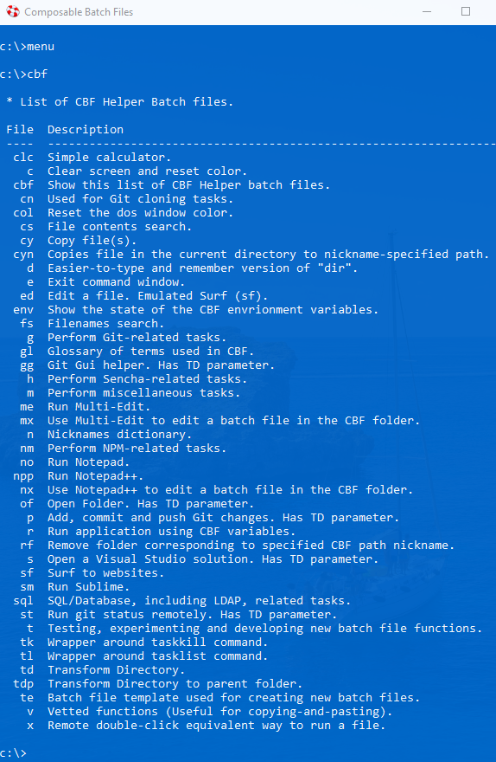
Menu
All of the batch files in CBF use a functionalized, modular approach.
To see a menu of all the available CBFs type "menu" or "cbf" at the prompt.

Slide 11
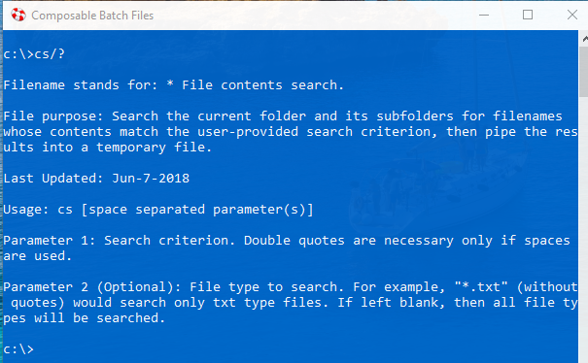
Getting Help
To get help with a particular batch file, at the prompt type "[batch file name]/?". For example:

Slide 12
Part III of III - Customization
Questions so far?

Slide 13
Customize CBF by Leveraging Environment Variables
Besides functionalization, another feature CBF promotes is leveraging environment variables in order to customize your CBF user experience. This is achieved by mapping nicknames/function names to environment variables. There is a CBF file named n.bat (Nicknames Dictionary) whose sole purpose is to do this mapping. For example, in n.bat, you could add a function with the nickname/function name of "docs" which maps the Documents folder to the cbf_path environment variable. Then because another batch file td.bat (Transform Directory) makes use of this mapping, typing "td docs" would navigate to the documents folder.

Slide 14
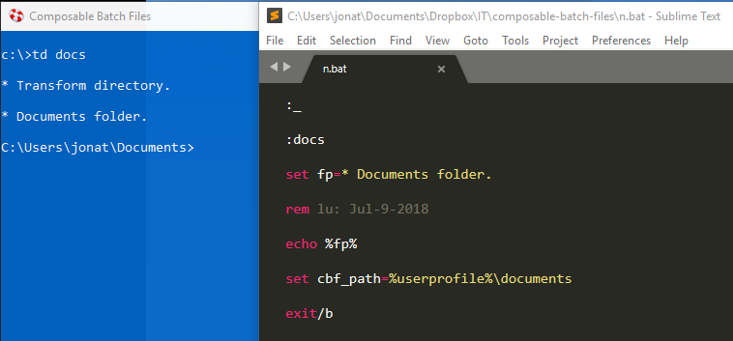
Using td is faster than cd.

Slide 15
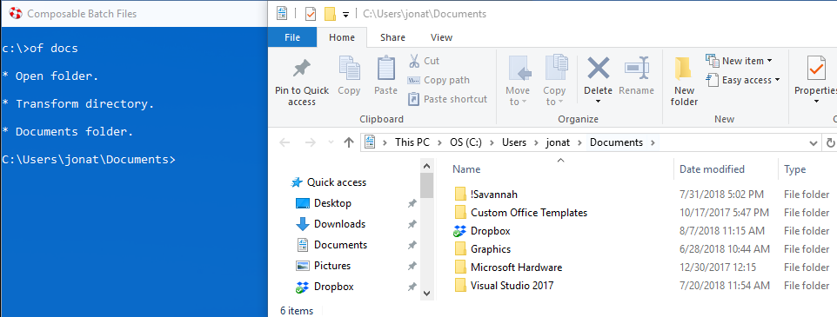
A few more customization examples.
Since of.bat (Open Folder) also leverages the "cbf_path" environment variable, typing "of docs" would open the documents folder in Windows Explorer.

Slide 16
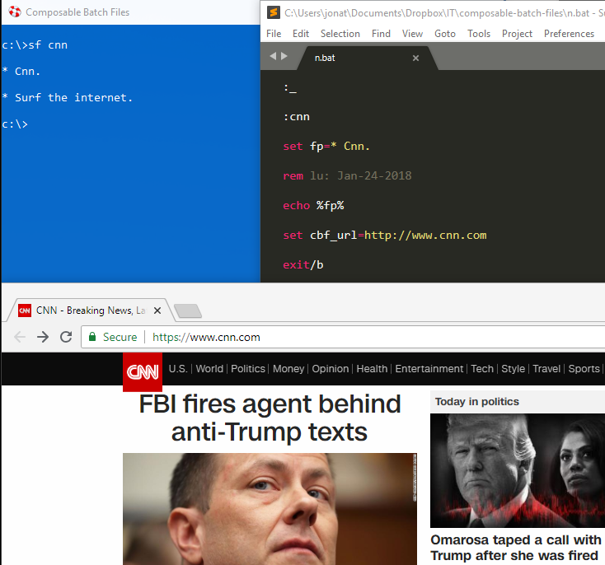
Sf.bat (Surf) leverages the "cbf_url" environment variable.

Slide 17
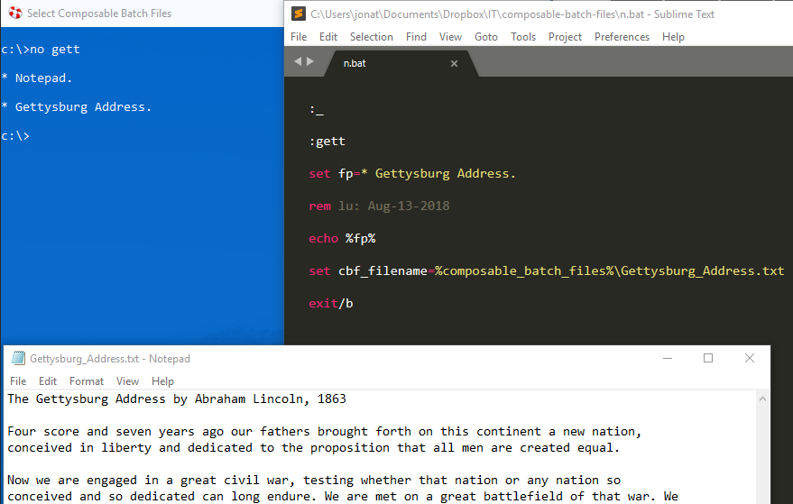
No.bat (Notepad) leverages the "cbf_filename" environment variable.

Slide 18
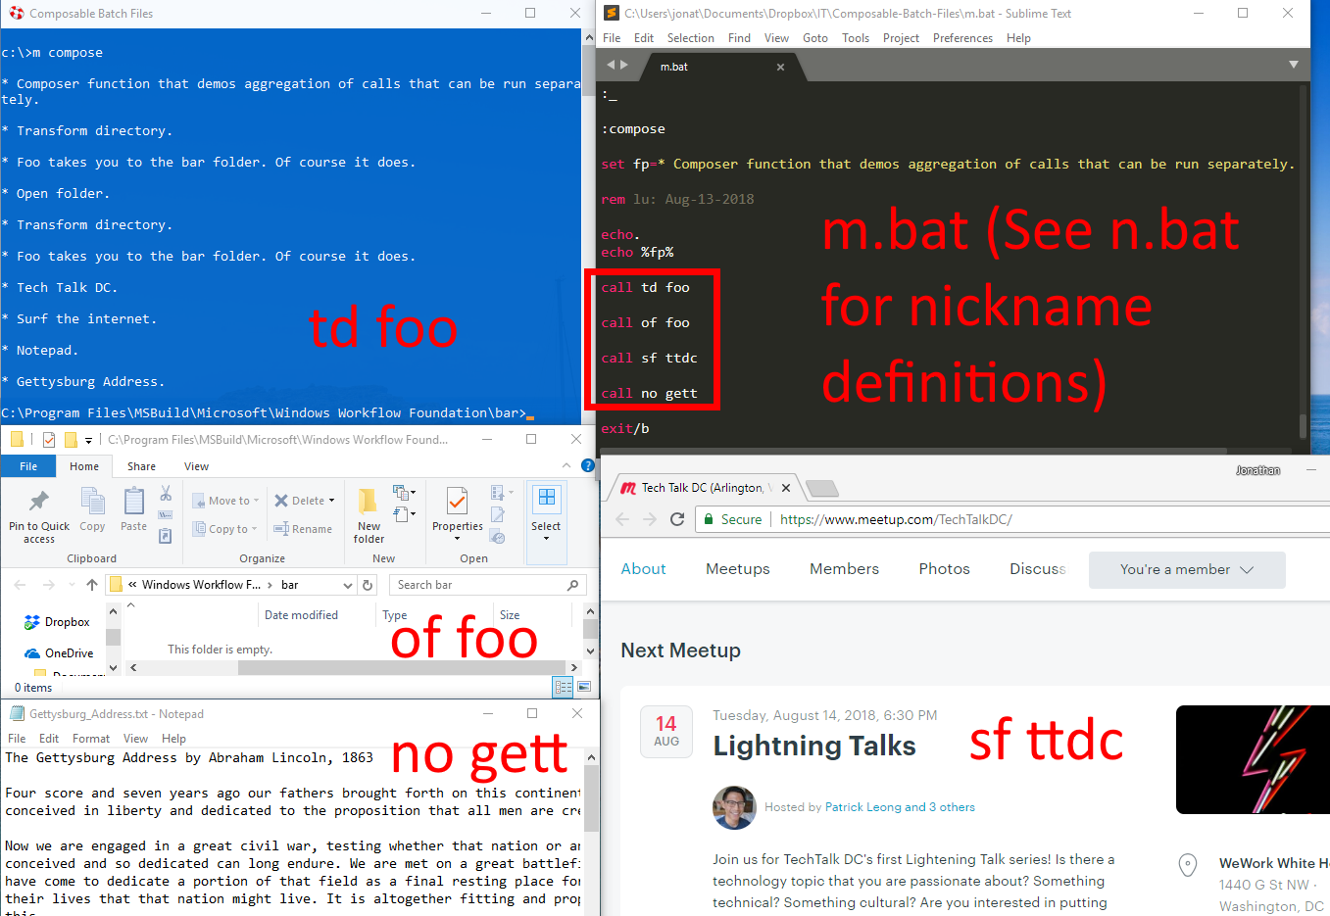
Composer Method – Run them all together.

Slide 19
Live Demo
Just to prove it works, run: m demo
Now that you know how navigate the file system, surf and edit like a boss, it’s time to search folders like a boss.
Some cool out-of-the-box batch files I use on a regular basis.
Run fs.bat, td ux, fs *.sln
know you can do the same thing in Windows Explorer, but you can use this method if you prefer the command line or perhaps need a text file of the search results.
Run cs.bat, td ux, cs UriImageSource *.cs

Slide 20

Questions? To download and for more info., see:

